Slide 1
Hadoop framework: Understanding its components and how is it supporting Big Data
Leonardo Deana
Paul Kim
May 20, 2015

Slide 2
Final Report Information
Team email
Leonardo.deana@ge.com
Hyeunkyu.kim@ge.com
GitHub account
465-leodeana
Directory: Project_Report
link: https://github.com/futuresystems/465-leodeana/tree/master/Project_Report
Artifacts
Survey paper, Project Presentation and Project Proposa which will be posted in the GitHub repository informed.

Slide 3
Final Report Description
We will do a survey paper on main concepts of the Apache Hadoop framework, explaining its:
Components
Map Reduce, HDFS, Zookeeper, etc.
Advantages and disadvantages compared to other tools
Best applications
How it’s supporting big data in large companies
New trends on this technology

Slide 4
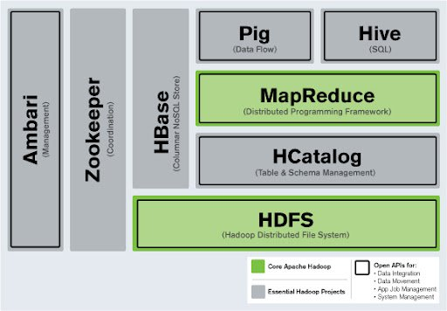
Apache Hadoop Subprojects

Slide 5
Report objectives
We aim to have an deep understanding of apache Hadoop key functionalities and its support in big data for large corporations, including GE if no proprietary issues.
Proprietary Issues:
The reports aims to use public data and other papers/articles as references which will be proper indicated at the references page.
Also, we will only use GE public information regarding this subject.

